Slide 1
Nuclear Fuel Performance
NE-533
Spring 2023

Slide 2
Last time
Fission gas release models are used to understand fission gas experiments and to predict gas release for fuel performance codes
Spherical grain models predict a fraction of gas release for post-irradiation annealing or for in-pile gas release
Booth model takes Stage 1 into account; Forsberg-Massih model takes Stage 1 and 2 into account
Fission gas diffusivity behavior changes with temperature and fission rate
Many materials models for fuel are empirical and correlated to burnup
Fuel pellets change shape due to
Thermal expansion (increase in volume); Densification (decrease in volume); Swelling (increase in volume); Creep (volume stays the same)

Slide 3
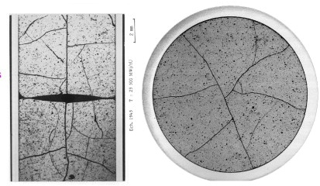
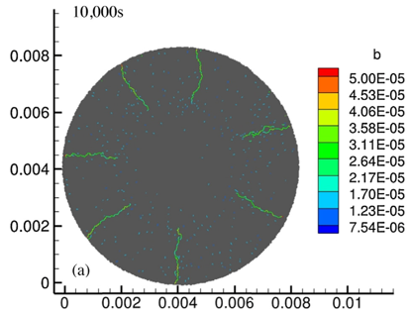
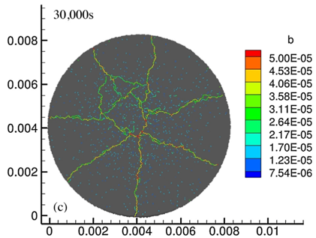
Fracture
UO₂ pellets fracture during changes in temperature due to large thermal stresses
Fracture results in:
Increased gap reduction
Reduced thermal conductivity
Increased avenues for fission gas release
Fracture has been typically modeled in two ways:
Empirical relocation model that is a function of burnup
Semi-empirical smeared cracking model
Modern methods provide means of modeling discrete cracks
Radial cracks partially penetrate the pellet during temperature increase
Full cracking occurs when the temperature decreases

Slide 4
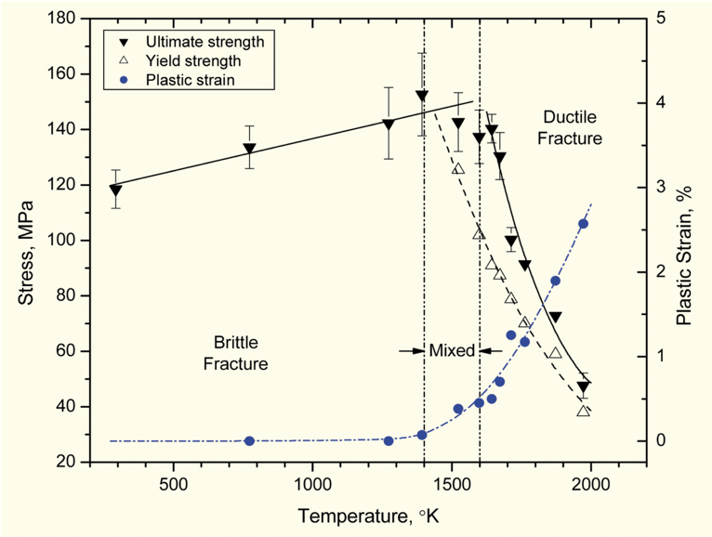
Fracture
The fracture behavior of the fuel is fairly complicated
Fracture strength varies with grain size (G)
σ_{frac} = G^{-m}σ_{frac, ref}, m = 0.04 – 0.05 (vs. m ~ 0.5 for metal)
Increasing grain size from 10 μm to 100 μm reduces σ_{frac} by ~10%
Ductility transition temperature is lower in-reactor than in thermal tests
Fracture strength is ~10× higher in compression than in tension
Load-deformation behavior strongly affected by creep under in-reactor conditions

Slide 5
Zirconium Cladding

Slide 6
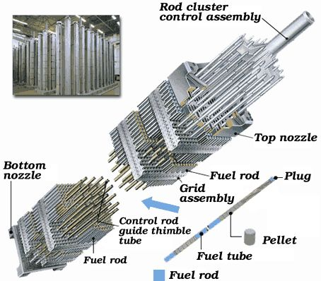
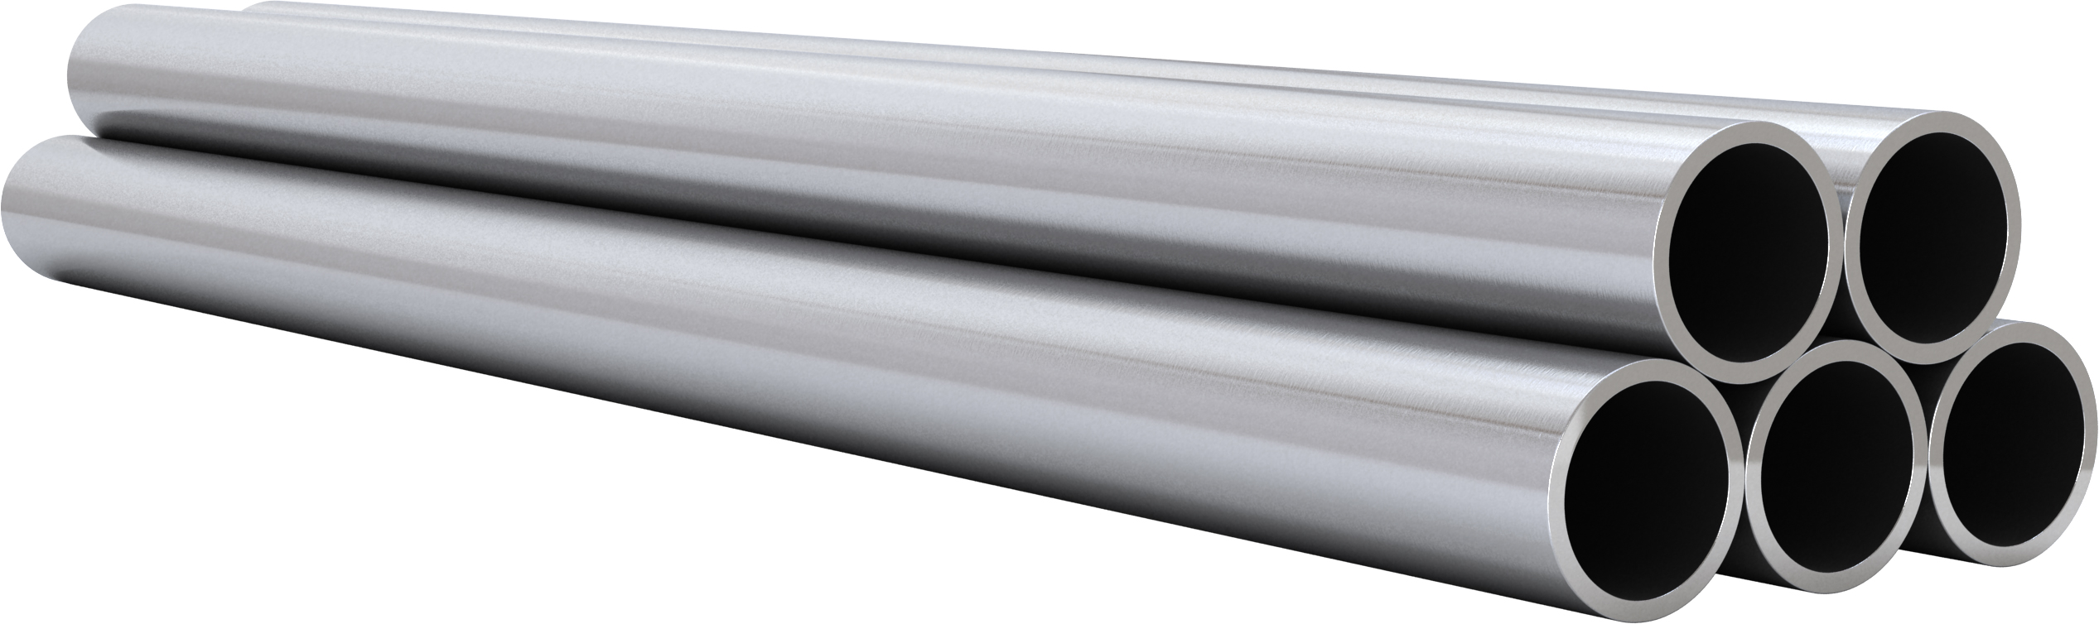
Cladding
The purpose of the cladding is to:
Hold the pellets together so that coolant can freely flow past
Transport heat from fuel to the coolant
Contain fission products
Contain fuel fragments
We would also prefer if the cladding had little to no impact on the neutron transport in the reactor

Slide 7
Why Zirconium alloys?
Benefits
Low neutron cross section
Corrosion resistance in 300˚C water
Resistance to void swelling
Adequate mechanical properties
Good thermal conductivity
Affordable cost
Available in large quantities
Problems?
Corrosion under high temperature steam
Hydride embrittlement
Anisotropic characteristics lead to creep and growth

Slide 8
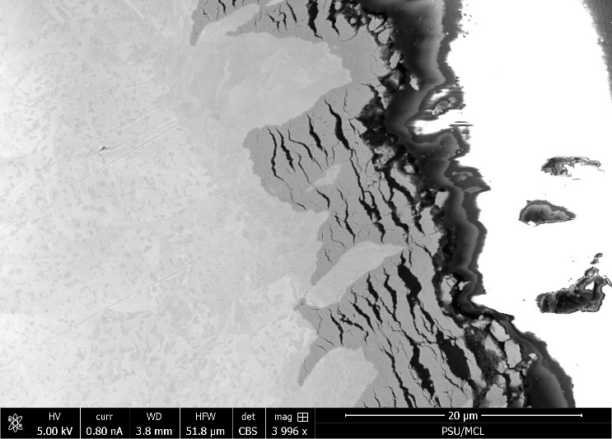
Zirconium
Pure zirconium was not acceptable due to its oxidation behavior
Oxygen with water reacted to form an oxide layer
The oxide layer is brittle and flakes off, allowing more oxidation to occur
Zr alloys were developed to reduce corrosion resistance

Slide 9
Commercial Zr Alloys in PWRs
Alloy | Sn % | Nb % | Fe % | Cr % | Ni % | O %
PWRs (structural components and fuel rods)
Zircaloy-4 (SRA) | 1.2-1.7 | - | 0.18-0.24 | 0.07-0.13 | - | 0.1-0.14
ZIRLO (SRA) | 1 | 1 | 0.1 | - | - | 0.12
Optimized ZIRLO (pRXA) | 0.7 | 1 | 0.1 | - | - | 0.12
M5 (RXA) | - | 0.8-1.2 | 0.015-0.06 | - | - | 0.09-0.12
HPA-45 (SRA/RXA) | 0.6 | - | Fe+V | - | - | 0.12
NDA (SRA) | 1 | 0.1 | 0.3 | 0.2 |  | 0.12
MDA (SRA) | 0.8 | 0.5 | 0.2 | 0.1 |  | 0.12
PRXA Partial Recrystallization Anneal
RXA Recrystallization Anneal
SRA Stress-Relief Anneal

Slide 10
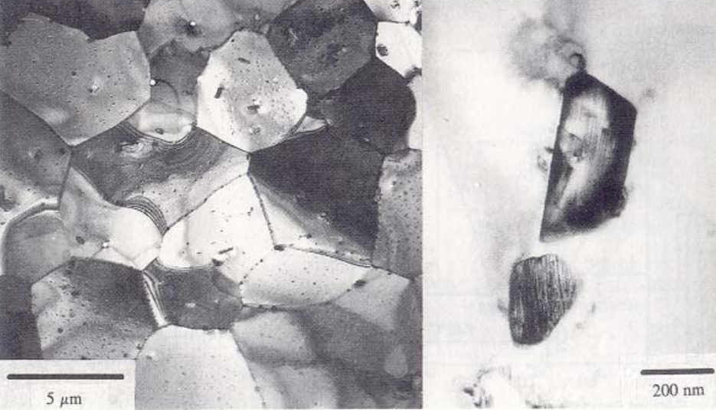
Alloying Elements
The alloying elements impact the microstructure of the material
The intermetallic precipitates significantly improve the oxidation behavior
In Zircaloy 2, the precipitates are
Zr(Cr, Fe)₂
Zr₂(Ni, Fe)
In Zircaloy 4, the precipitates are
Zr(Cr, Fe)₂
Phosphides (Zr₃P) and silicides (Zr₃Si) are also occasionally found
The precipitate distribution, size, morphology, and composition all impact the properties of the material

Slide 11
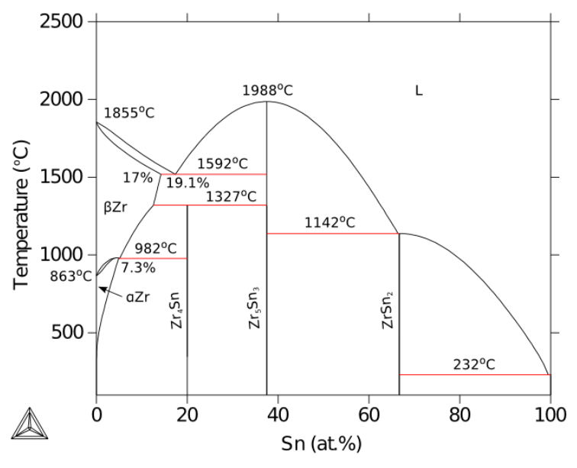
Zirconium Phases
The α-Zr phase has a hexagonal-close-packed (HCP) structure
At temperatures below about 863ºC
Has the most desirable properties
The β-Zr phase has a body-centered cubic (BCC) structure
We try to avoid this phase

Slide 12
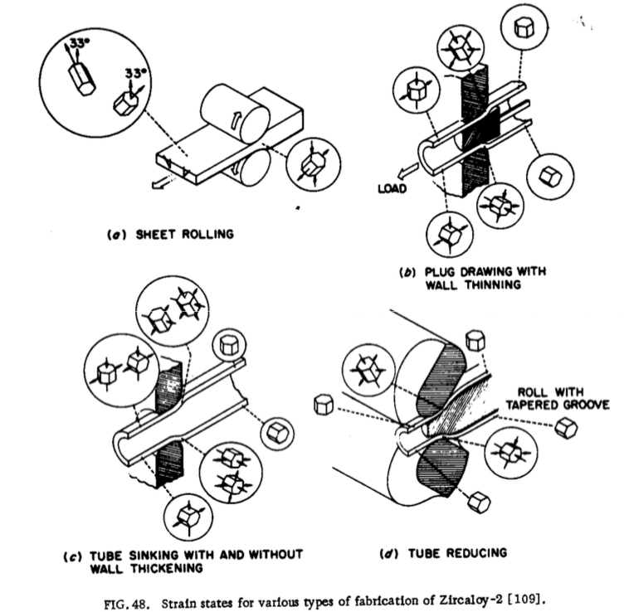
Zr Tube Fabrication
The cladding tubes are fabricated using various processes that SEVERELY deform the material
The severe plastic deformation causes significant dislocation hardening, that can make the tube material too brittle
Plastic deformation along slip planes results in reorientation of the grains
The properties of the material are controlled by heat treatment
Raising the temperature, but below 863˚C, anneals the sample to reduce cold work (stress-relieved)-SRA
Raising the temperature above 863˚C changes to the β phase. They then quench the sample to create a random texture in the α phase-RXA or pRXA

Slide 13
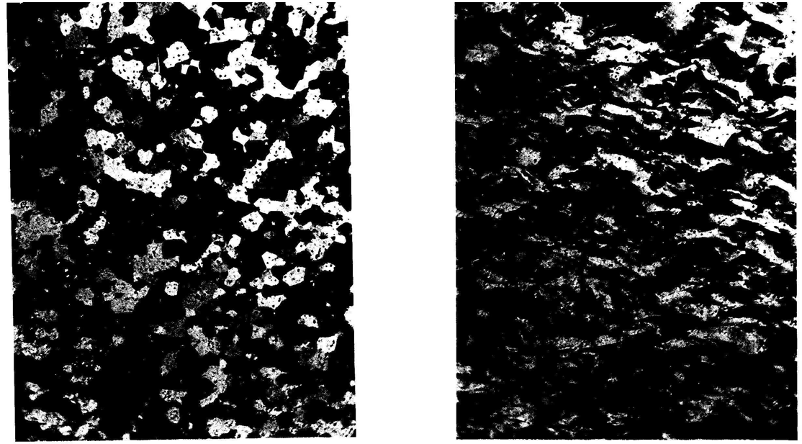
Zr alloy microstructures
Fully recrystallized after quench
Stress-relieved microstructure

Slide 14
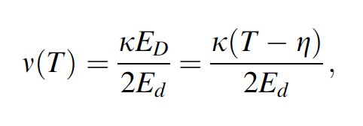
Zirconium Creep and Growth
The cladding undergoes a very large amount of irradiation during its life, the main effects are:
Interstitial loops form on prism planes
Later in the reactor exposure, vacancy loops form on the basal plane
The overall number of displacements to the cladding can be calculated with the NRT model to be ~ 8 x 10⁻⁸ dpa/s, which, over 3 years exposure gives a total of ~8 dpa (every atom in the solid is displaced on the average eight times)

Slide 15
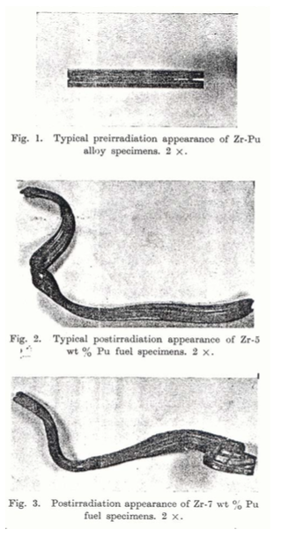
Irradiation Growth
Irradiation growth results from material anisotropy
There must be anisotropy in the defect behavior within the unit cell
There also must be a texture formed in the grain orientations
Interstitial loops form on pyramidal planes, causing shrinkage along the center axis
Later, vacancy loops form on basal planes, making it even worse
The result is a change in shape, shrinking in the 0001 direction and expanding in the pyramidal direction

Slide 16
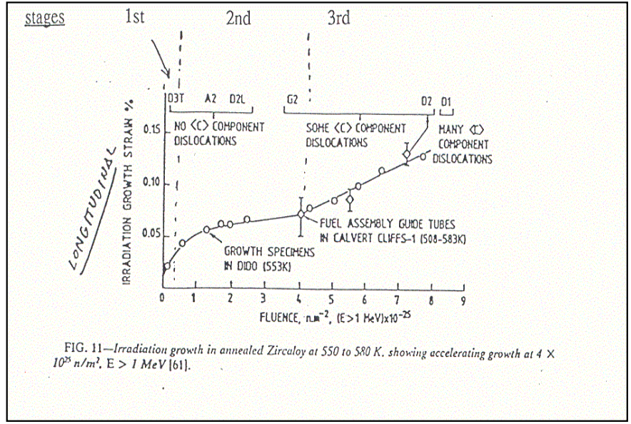
Irradiation Growth
Three stages of irradiation growth
Initial rapid growth to small strains
Slow growth, gets skipped in cold worked material
Accelerated or breakaway growth, caused by formation of vacancy loops on the basal plane
Irradiation growth is affected by:
Fluence, Cold work, Texture, Irradiation temperature, Material chemistry, Hydrogen effects

Slide 17
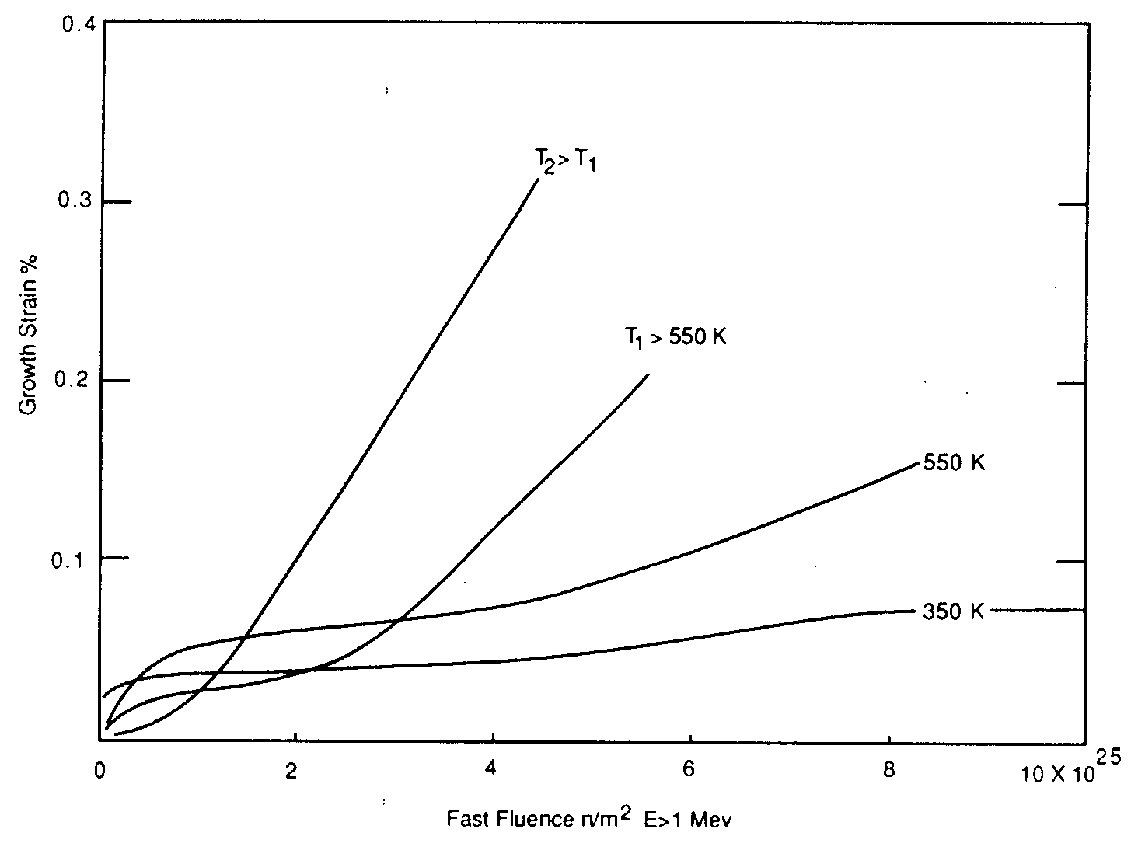
Irradiation Growth
Higher temperature leads to earlier breakaway and higher growth
Higher temperature adds mobility to defects, allowing them to diffuse faster, form clusters, and exacerbate the defect cluster induced anisotropic growth

Slide 18
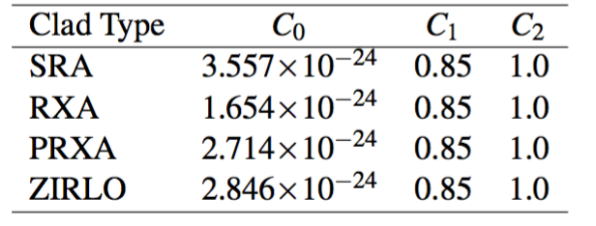
Creep
Empirical models have been developed for thermal and irradiation creep of Zircaloy
Both based on the Von Mises stress
Thermal Creep
With A₀ = 3.14 × 10²⁴ (1/s); shear modulus G = 4.2519 × 10¹⁰ − 2.2185 × 10⁷T Pa; n = 5; Q = 2.7 × 10⁵ J/mol
Irradiation Creep
ϕ is the fast neutron flux n/(cm² s) = 3E11xLHR n/(cm²-s)
Note that SRA stands for stress relief annealed
RXA for recrystallization annealed
PRXA stands for partially recrystallization annealed

Slide 19
Creep Example
Consider an SRA cladding tube at T = 600 K and LHR = 250 W/cm, with a stress σ_{m} = 200 MPa. What is the total creep strain after three years?
First, we will calculate the thermal creep
A₀ = 3.14 × 10²⁴ (1/s)
G = 4.2519 × 10¹⁰ − 2.2185 × 10⁷T Pa = 4.2519e10 − 2.2185e7*600 = 2.92e10 Pa
Q = 2.7 × 10⁵ J/mol, n = 5, R = 8.3144598 J/(K mol)
3.14e24*(200/2.92e4)^5*exp(-2.7e5/(8.3144598*600)) = 1.48e-10 1/s
Now we will calculate the irradiation creep
C₀ = 3.557e-24, C₁ = 0.85, C₂ = 1.0
Φ ≈ 3e11 LHR = 3e11*250 = 7.5e13 n/(cm² s)
3.557e-24*(7.5e13)^0.85*200^1 = 4.43e-10 1/s
The total creep strain rate is 1.48e-10 + 4.43e-10 = 5.91e-10 1/s
The total creep strain after three years is (assuming constant conditions) 5.91e-10*(3600*24*365*3) = 0.056 = 5.6% strain

Slide 20
Creep
Creep impacts fuel performance by shrinking the gap and then conforming to the pellets
a) before “fuel-cladding” interaction; b) start of “fuel-cladding” interaction; c) “fuel-cladding interaction” over most of fuel column
(1)creep down from water pressure; (2)creep out from fuel column; (3)fuel column axial stress

Slide 21
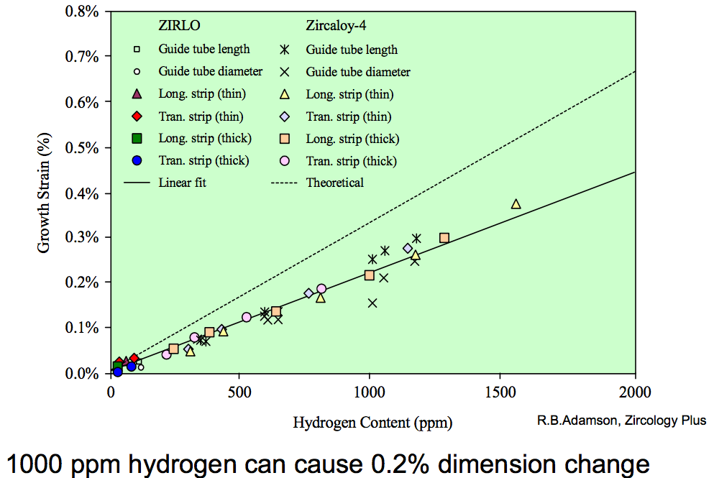
Zirconium Hydrides
Hydrides cause size change because the hydride lattice is larger than the zirconium lattice
There are a number of different Zr-H phases and morphologies that can present
0.1% H can cause 0.2% growth

Slide 22
Summary of Creep and Irradiation Growth
Growth and creep are the major mechanisms for dimensional instability in zirconium alloy cladding
Growth results from the clustering of interstitials on prismatic planes, and eventually from the clustering of vacancies on basal planes such that the material shrinks in the axial direction
Growth depends on the fluence, coldwork, texture, temperature, and composition

Slide 23
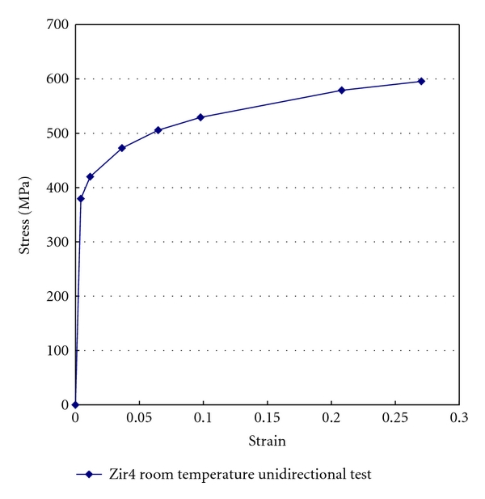
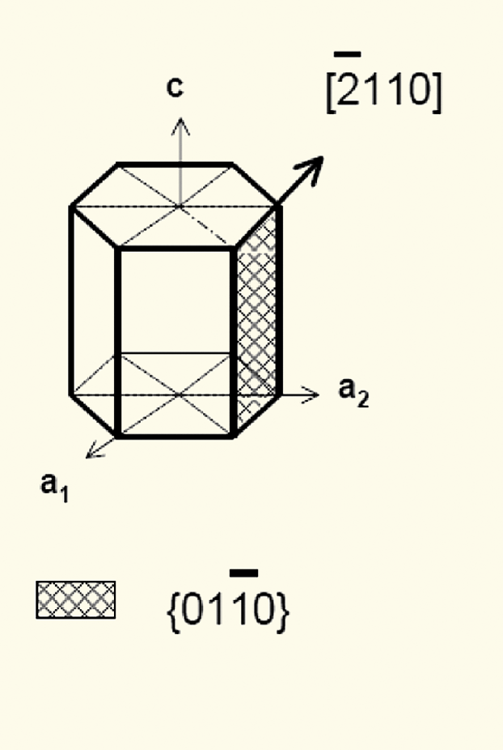
Mechanical Behavior of Zr Cladding
Zirconium alloys plastically deform primarily due to dislocation motion on prismatic planes

Slide 24
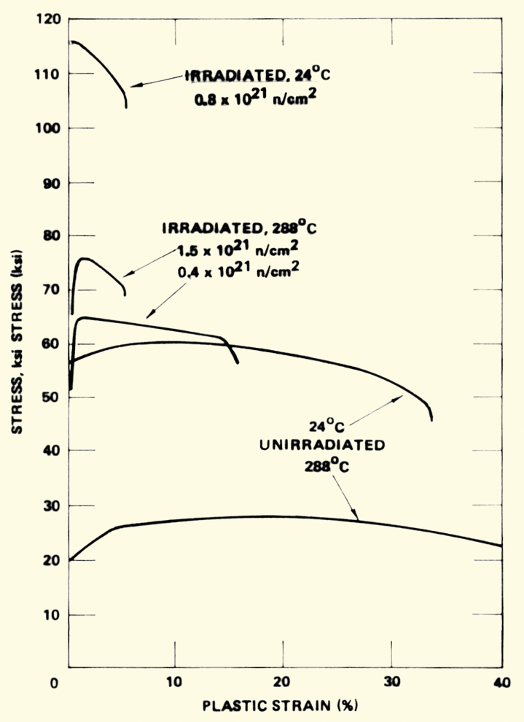
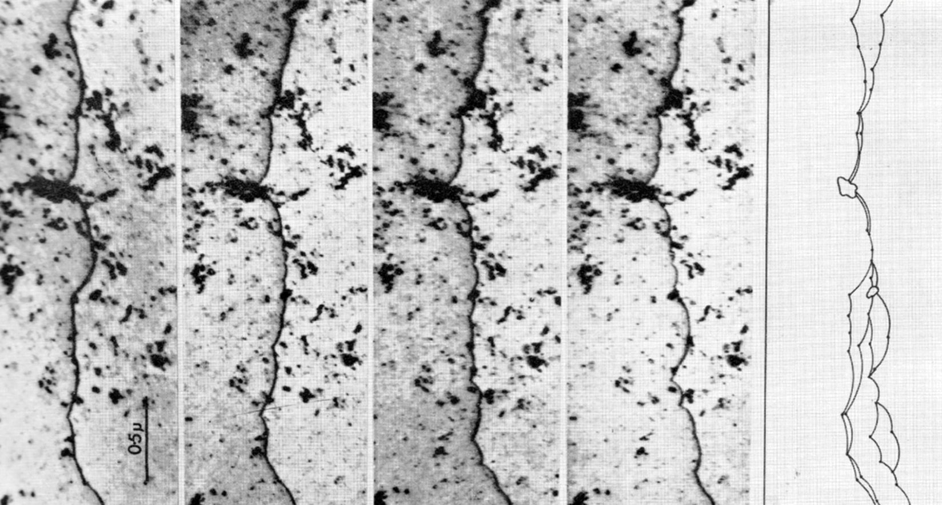
Irradiation Hardening
Under irradiation, the interstitial loops that buildup on the prismatic planes cause hardening
The UTS goes up with fluence, while the strain before fracture goes down
dislocation is moving

Slide 25
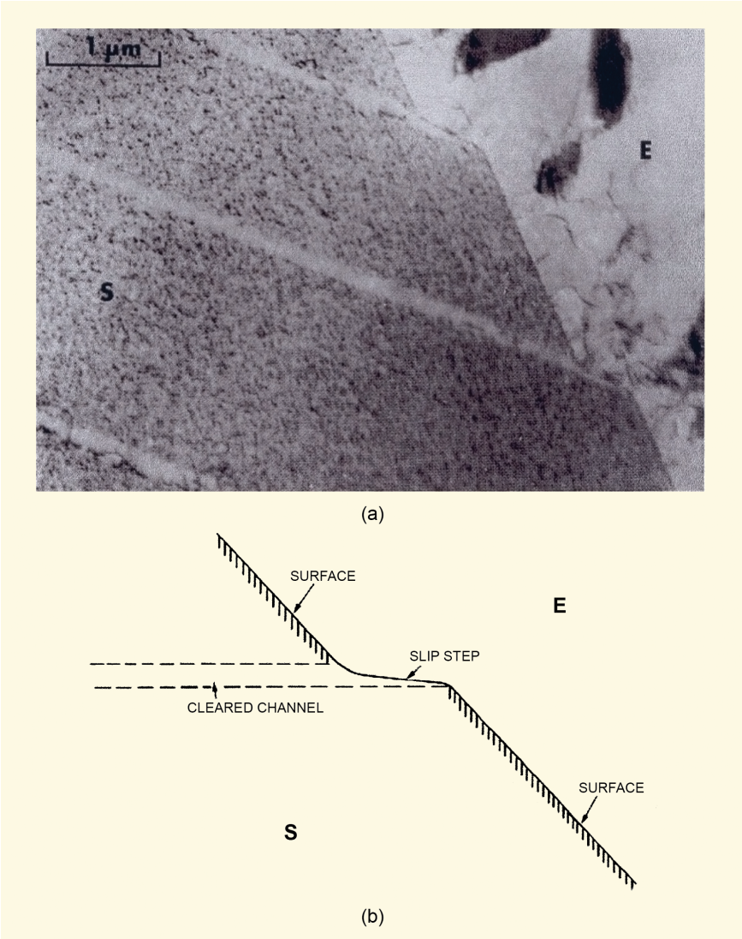
Dislocation Channels
When stress is high enough, loops are “swept away”, forming a clean channel
Once a channel is cleaned out, dislocations continue to move along it
This results in lots of deformation in that one area, creating slip steps
In HCP zircaloy, channels form on basal planes or prism planes depending on
Load direction
Temperature
Oxygen content in the alloy
Fluence

Slide 26
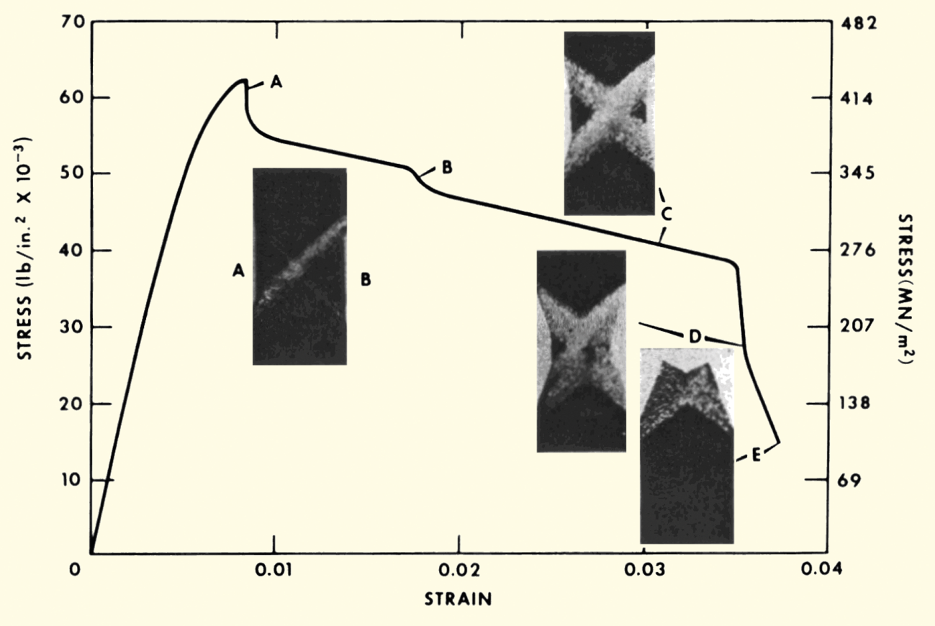
Dislocation Channels
Channel formation is an important behavior in irradiated zircaloy
Dislocation channel deformation occurs at high load or high fluence

Slide 27
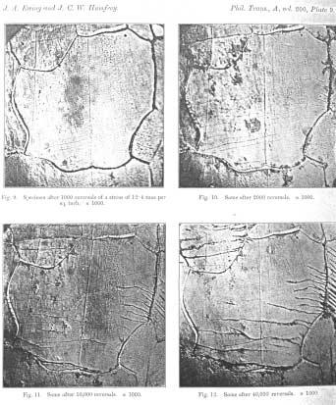
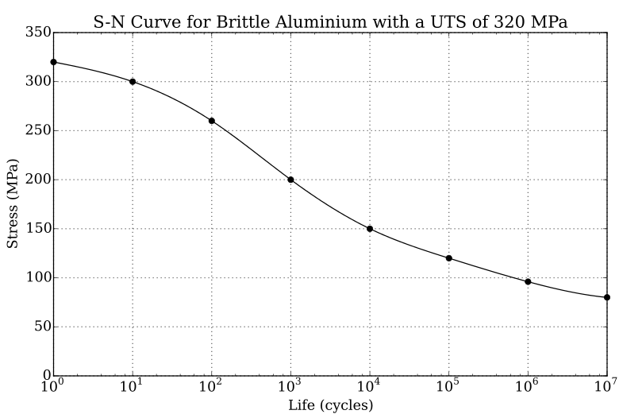
Fatigue
Material fatigue is the weakening of a material caused by repeated applied loads
Materials under cyclic loading can experience brittle like fracture at stresses significantly below their UTS
It is caused by the slow propagation of microstructure damage
The engineering tool for investigating fatigue is the S-N curve
An S-N curve is a graph of the magnitude of the cyclic stress (S) against the logarithmic scale of cycles to failure (N).

Slide 28
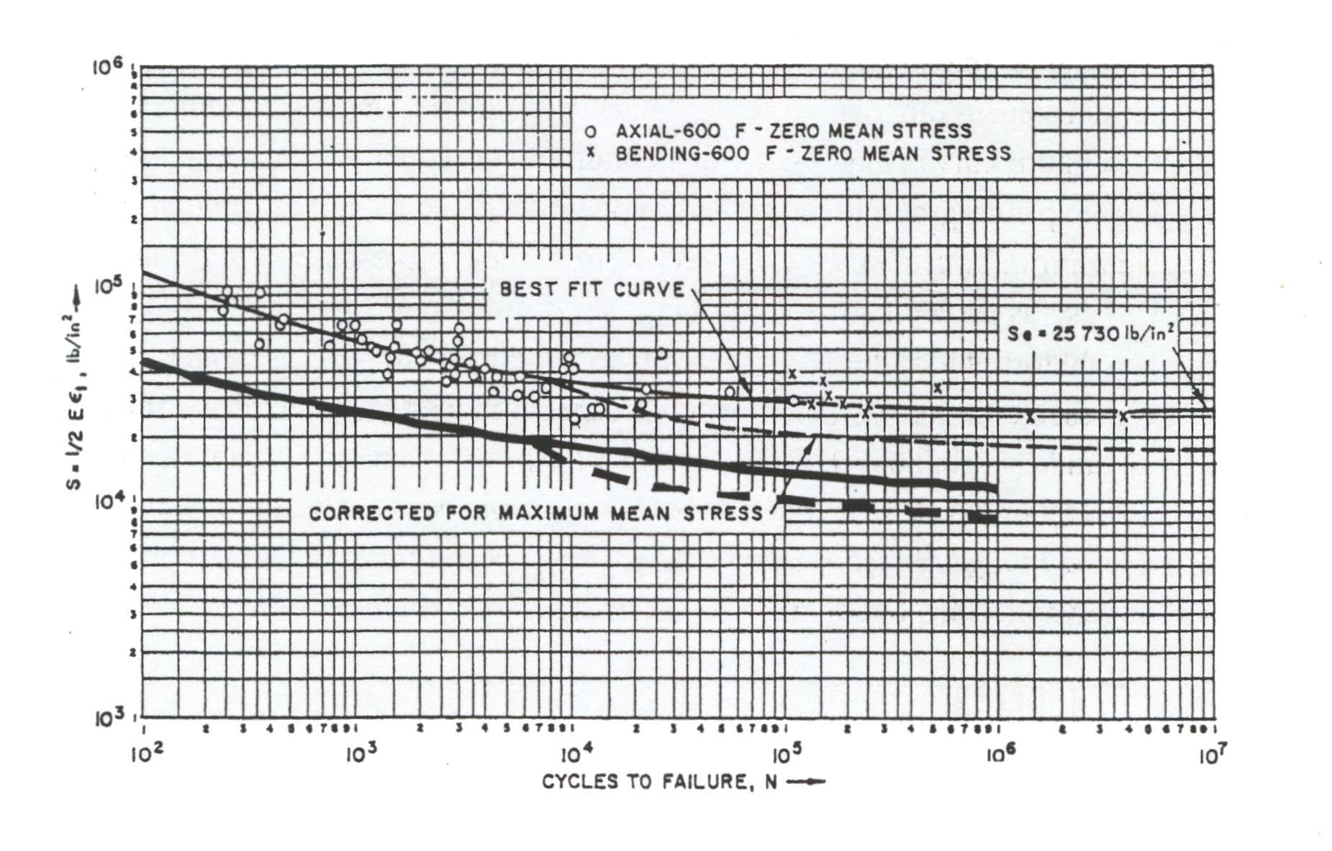
Zr Fatigue
Zircaloy experiences fatigue like other metals
Zircaloy has a fatigue limit at about 10⁵ cycles with 180 Mpa (The UTS is >500 Mpa)
Irradiation slightly lowers the fatigue life in the low cycle range, less than about 10⁴ cycles
Irradiation has no effect on the fatigue life on the high cycle range, greater than about 10⁵ cycles
Design must demonstrate a factor of safety of 2 on stress and 20 on cycles

Slide 29
Pellet Cladding Interaction (PCI)
PCI includes both mechanical (PCMI) and chemical interaction (PCCI), often seen in a more general sense FCMI and FCCI
The process of PCI involves the combination of high internal mechanical stress in the cladding and a corrosive environment resulting from the accumulation of volatile fission products in the fuel-clad gap
These conditions may lead to the initiation and propagation of radial cracks, which can penetrate through the cladding
Frequent PCI failures were observed in the 1960s and 1970s, leading to extensive research efforts
Altering operational procedures, modifying the manufacturing process of the cladding, adding a composite layer and/or applying a protective coating to the inner cladding surface can help mitigate these failures

Slide 30
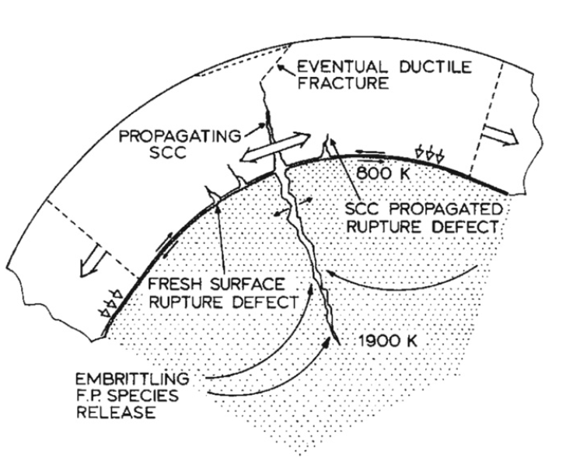
Physical Phenomena in PCI
The fuel thermally expands and swells
The cladding undergoes thermal and irradiation-induced creep
Mechanical interaction between the fuel pellet and cladding generates radial compressive stresses in addition to tensile hoop stresses
Volatile fission product gases are released into the gap
The cracking of the fuel pellet together with non-uniform thermal expansion resulting in preferential contact at the pellet interfaces increases local mechanical stresses in the cladding

Slide 31
Stress Corrosion Cracking (SCC)
Alloys that are in a corrosive environment may develop cracks that would not otherwise develop in the absence of either stress or the corrosive environment – stress corrosion cracking (SCC)
Stress corrosion cracks may propagate along intergranular (IG) and/or transgranular (TG) paths
The propagation modes of these cracks may depend on the localized mechanical and chemical conditions that lead to SCC
In order for SCC to initiate and propagate in any material, four conditions are simultaneously required:
A corrosive environment, a susceptible material, sufficient stress, and sufficient time

